Slide 1
HOW THE COMPILER WORKS
Linker and Memory Sections

Slide 2
Objective
Understand how a C source becomes binary code for processor
Understand more about memory of processor
Understand Linker Memory sections and usage

Slide 3
Contents
Processor Architectures
C to binary process
Preprocessor
Compiler
Linker

Slide 4
Processor Architecture
Harvard
Flash and SRAM on independent buses
Von-Neumann
Flash and SRAM on same bus
Modified Harvard
Flash and SRAM independent but cross coupled.

Slide 5
What is Flash vs SRAM
Flash keeps contents when power removed.
Flash has limited number of erase/writes
Flash is slow relative to SRAM (2-4x slower)
SRAM requires larger space on silicone and consumes more power to operate

Slide 6
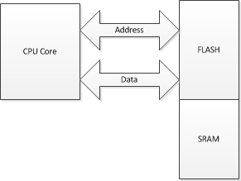
Von-Neumann

Slide 7
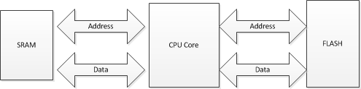
Harvard

Slide 8
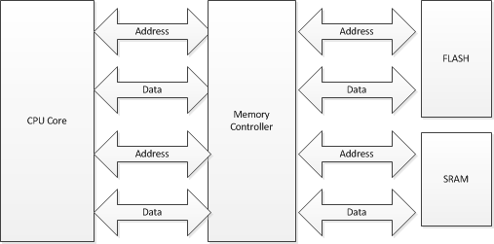
Modified Harvard
Allows Flash to be mapped to SRAM bus and vise versa.

Slide 9
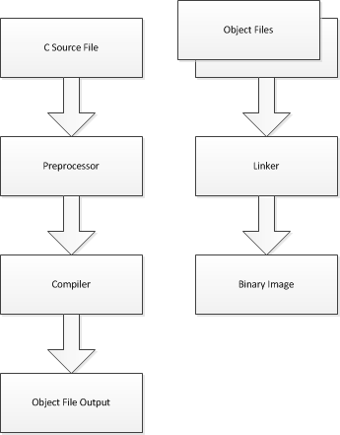
Compiler Process

Slide 10
Preprocessor
Preprocessor is macro expansion tool
Different compilers have different preprocessors (syntax might be slightly different)
Preprocessor instructions usually start with a “#”

Slide 11
Compiler and Memory Sections
Most processors have at least two types of memory:
FLASH non volatile memory
SRAM volatile memory

Slide 12
Compiler
Converts the source code to object file.
Object file is a binary instructions for processor along with meta data for Linker

Slide 13
Linker
Links the object files together to create a binary image that can be loaded into processor

Slide 14
Memory Sections
Text
Bss
Data
Heap
Stack

Slide 15
.text
The .text section contains the code and constant data. This section of memory is usually mapped to the flash memory.
For example the actual instructions to implement printf function are stored in the .text section.

Slide 16
.bss
BSS (from Block Started by Symbol) originally was an operation in the UA-SAP (United Aircraft Symbolic Assembly Program). The BSS keyword was later incorporated into FAP (FORTRAN Assembly Program), IBM's standard assembler for its 709 and 7090/94 computers. It defined a label (ie. symbol) and reserved a block of uninitialized space for a given number of words (Timar 1996). (from Wikipedia)
Today it represents a section of data memory (think SRAM) that contains variables (usually unintilized ones but not always).

Slide 17
.data
Data section contains global and static variables that are initialized by the program.
const char str[]=“Hello World”;
void main(void){
printf(“%s”,str);
}
Quiz: Where is “Hello World” stored before program starts? We will address this shortly.

Slide 18
heap
Heap is a section of memory usually managed by malloc and free.

Slide 19
Stack
The Stack is a section of memory that is uses as a LIFO memory area. The stack is used for local function variables and passing parameters to functions

Slide 20
SRAM Layout
0x000
.data
Stack starts at last address in data memory (sram) and grows downward.
Stack overflow is when stack grows into heap and/or bss section.
.bss
heap
stack
0xFFF

Slide 21
Data Section
const char str[]=“Hello World”;
void main(void){
printf(“%s”,str);
}
“Hello World” string is stored in flash
str variable is actually in SRAM

Slide 22
Memory layout before reset
Flash Memory
H | E | l | l | o | <SP> | W
o | r | l | d
str
SRAM Memory

Slide 23
Memory layout before main()
Flash Memory
H | E | l | l | o | <SP> | W
o | r | l | d
str
H | E | l | l | o | <SP> | W
o | r | l | d
SRAM Memory
CRTx_xxx, crt0 (C runtime) startup code did the copying. Specifically crt0 initializes .bss to zero (most of the time) and copies over initialization constants like above.

Slide 24
Heaps
Malloc is evil in embedded world unless closely managed.
For example we have three functions:
F1 allocates 500 bytes
F2 allocates 300 bytes
F3 allocates 200 bytes
Our heap space demands depends on the code execution order and free order. For example:
F1 called, then F2, F1 freed, then F3 called. In this case we need 700 bytes of heap.
F1 called and freed then F2 called, then F3. Now we only need 500 bytes of heap.
F3 called, then F1 called, F3 freed, then F2 called. Now we need 800 bytes of memory.
Remember heap requires contiguous memory area.
Heap allocations can create latent bugs that appear after product is shipped thus on embedded devices it is often better to statically allocate.

Slide 25
Stack and Frame Pointers
Most processors (well most ones worth a penny) have dedicated stack pointer registers for use with C compilers.
The stack starts at the end of SRAM and grows downward.
Note: For xmega all variable length function arguments are stored on stack, regardless of number of arguments.

Slide 26
Stack Example
F1 calls function F2.
The frame pointer points at return address.
When F2 is done the stack pointer is set to frame pointer minus size of F2 parameters.
Stack Pointer
F2 Local Variables
Return Address
Frame Pointer
F2 Parameters
F1 Local Variables
Return Address
F1 Parameters
0xFFFFF

Slide 27
Frame Pointer
Some compilers will push the previous frame pointer on the stack before (or after) return address to make return from function faster.
Stack Pointer
F2 Local Variables
Return Address
Frame Pointer
Previous Frame Ptr.
F2 Parameters
F1 Local Variables
Return Address
Previous Frame Ptr.
F1 Parameters
0xFFFFF

Slide 28
Stack and Local Variables
void f1(void) {
char str[255];
static int i=1;
……. }
str is stored on stack
i is a static variable stored in the data section.
What if we recursively called f1 a lot? Bingo a stack overflow.

Slide 29
Stack Overflow
Stack overflow happens when the stack grows into the heap (or bss section if you do not have heap).
Note that if you use the standard C library the functions like printf() will often use malloc and heap with out your knowledge.
0x000
.data
.bss
heap
stack
0xFFF

Slide 30
Detecting Stack Overflows
One method is to write a know string at end of heap and check to see if changed.
Some processors for the debugger have interrupts that trigger on address match. For example if you set a break point for when a variable changes. If you have this and not running in debug mode you can often utilize this to get an interrupt when you are close to a stack overflow.
Most people just move forward blindly and hope for the best which usually works.

Slide 31
Stack and Recursive Functions
Not all recursive functions result in stack overflows.
This is an example of tail recursion which does not cause stack to grow. Requirements for tail recursion are:
No local variables that can not be allocated in registers.
Return value is the function call
Note that this function will never exit!
void f1(int a) {
return f1(a*a);
}

Slide 32
Interrupt Vectors
Most processors use vector interrupts
Vectors are memory locations that usually contain jump instructions
Ox0000 (reset vector) | JMP crtx_xxxx
0x00004 | JMP xxxxx
ox00008 | JMP xxxxx

Slide 33
Interrupt Vectors
Various processors handle interrupt vectors differently. For example:
Xmega has interrupt vectors in flash memory
LPC2368 ARM7 have them in SRAM (If I remember correctly).
So for the LPC the interrupt vectors are actually copied from Flash to SRAM in crt0…

Slide 34
Xmega’s Flash Memory
Interrupt Vectors (duplicated at start of boot loader)
Application – where your code is stored
Application tables – Area for user data the firmware might want to change while running
Bootloader – second application area usually used for a bootloader
Note xmega also has EEPROM memory.
0x1000
Interrupt
Vectors
Application
Application Tables
BootLoader
0xFFF

Slide 35
Bootloader
Bootloader is a piece of code that runs on boot up of the processor which can load code into flash memory.

Slide 36
xMega’s other memory
Flash begins at an offset, like 0x1000, before this is the memory mapped prepherials, special function registers, etc.
xMega also has EEPROM memory which software can use to save data/variables as needed.

Slide 37
Linker
The compiler generates object files (*.o) from c source files (*.c).
The Linker then takes all the object files and links them together into memory.
The linker uses a script (linker script) as a map of what type of memory is available and how much.

Slide 38
Linker Scripts
Linker scripts are often tough to understand. This is often due to little or not documentation provided by compiler developers.
We often result to trial and error when working with linker scripts, another good reason to use GCC where you learn once.

Slide 39
Xmega Linker
The xMega linker scripts are abstracted from developer. They are actually stored in:
C:\WinAVR-20100110\avr\lib\ldscripts
However determining which one your processor uses is often a painful process but worth education.

Slide 40
Linker Script Memory area
Simple map of the processor’s memory
MEMORY
{
text (rx) : ORIGIN = 0, LENGTH = 1024K
data (rw!x) : ORIGIN = 0x802000, LENGTH = 0xffa0
eeprom (rw!x) : ORIGIN = 0x810000, LENGTH = 64K
fuse (rw!x) : ORIGIN = 0x820000, LENGTH = 1K
lock (rw!x) : ORIGIN = 0x830000, LENGTH = 1K
signature (rw!x) : ORIGIN = 0x840000, LENGTH = 1K
}
Quiz: is this our processor?

Slide 41
Linker Script Section area
SECTIONS
{
/* Read-only sections, merged into text segment: */
.hash : { *(.hash) }
.dynsym : { *(.dynsym) }
.dynstr : { *(.dynstr) }
.gnu.version : { *(.gnu.version) }
.gnu.version_d : { *(.gnu.version_d) }
.gnu.version_r : { *(.gnu.version_r) }
.rel.init : { *(.rel.init) }
.rela.init : { *(.rela.init) }
.rel.text :
{
*(.rel.text)
*(.rel.text.*)
*(.rel.gnu.linkonce.t*)
}
.rela.text :
{
*(.rela.text)
*(.rela.text.*)
*(.rela.gnu.linkonce.t*)
}
…………………
……………..
And on and on and on

Slide 42
Linker Script Key Points
Linker script can create #defines.

